Slide 1
Networking -- DNS, SSL, HTTP and MCP
Leonidas Kontothanassis

Slide 2
Let’s access a website
http://142.251.167.91 (www.google.com)
Small digression (Chrome developer tools)
How about this one https://142.251.167.92? (www.youtube.com)
How about this one: http://151.101.117.164/ (www.nytimes.com)
Why doesn’t it work?

Slide 3
Domain Name System (DNS)
A widely distributed collection of databases that translate between names and IP addresses
A protocol for talking to those databases
A schema for inserting/deleting/updating these databases

Slide 4
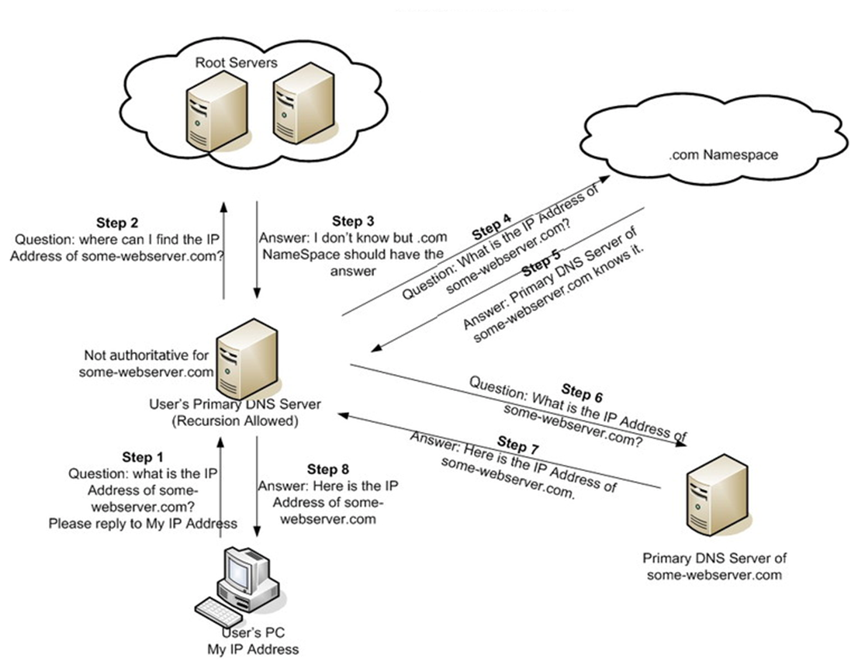
The DNS Hierarchy

Slide 5
DNS Definitions
Client resolver
Local library that interacts with name servers
Recursive nameserver
A nameserver that doesn’t know the answer but knows who to ask. May cache the results
Authoritative nameserver
A nameserver that knows the answer to a particular domain
Root name server
Key 13 name servers that are known to everyone and know about top level domains (i.e. .com, .net, .edu, .org etc).
Use anycast to scale
TLD name server
Name servers handling resolution under .com, .net, .edu, .org etc.

Slide 6
Anycast (Digression)
Use BGP to advertise same IP from many places
BGP picks closest location to route requests to
Works great for single packet request/response
Can work pretty well for multi-packet communication
Stable anycast is an option

Slide 7
DNS definitions
Domain name server
One that can answer what is the IP of a particular host in that domain
Load balancing name server
One that can provide a different answer based on who is asking and load conditions on the actual content serving hosts
Zone file
A file containing the mappings between names and IP addresses
TTL
An indicator on how long the answer is valid for

Slide 8
DNS Records
SOA record (Start of Authority)
Metadata about the zone file and records that follow
A and AAAA records
Actual IP resolutions
CNAME records
A new domain name that is an alias to the question
MX records
Provide the names of the mail servers for the domain
NS records
Names and IP addresses of the name servers for the domain
PTR records
Used for reverse resolutions
TXT records
Any string you want to associated with a host name
CAA records
Names of cert authorities issuing certs for the domain
Nice overview at https://www.digitalocean.com/community/tutorials/an-introduction-to-dns-terminology-components-and-concepts

Slide 9
The dig tool
dig name
dig ns name
Available in your cloud shell
dig --help or man dig for details

Slide 10
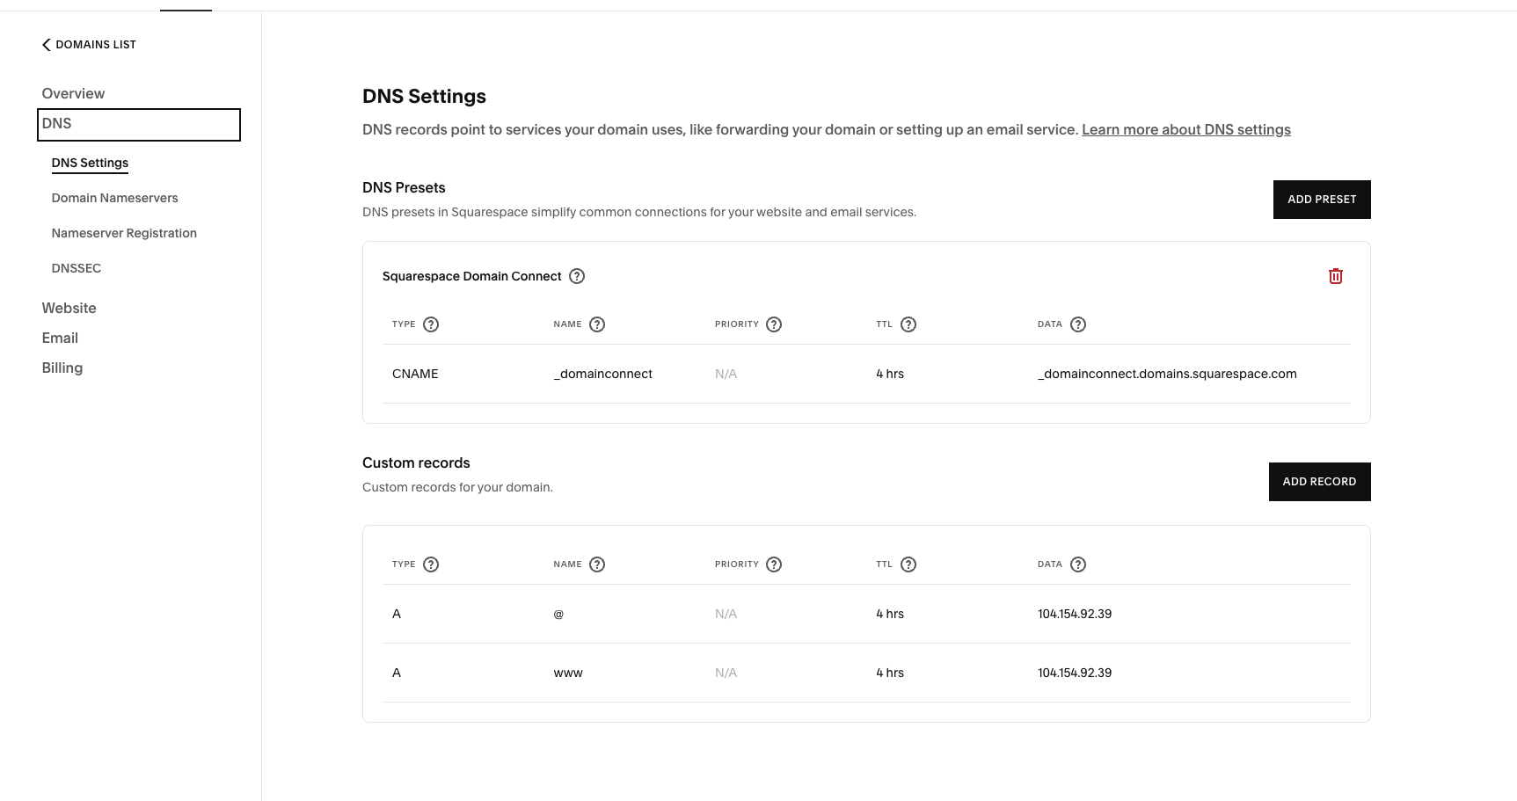
Setting up DNS on GCP
Setting up a domain
Console for setting up DNS

Slide 11
Secure Socket Layer and Transport Layer Security (SSL/TLS)
The golden standard for encrypting public communications. Must provide
Encryption: Hide the content of messages
Integrity: Make sure no-one can tamper with message
Authentication: ensure the participants are who they say they are
SSL is now deprecated in favor of TLS which stands at version TLS 1.3

Slide 12
Encryption and Integrity
Integrity is relatively easy. A checksum or other signature is added to the content before encryption. Upon decryption it can be verified.
Encryption typically uses Advanced Encryption Standard (AES) these days.
Makes heavy use of xor, shifting, mixing and substitution operations.
Relies on an agreed upon secret key. Divides content into 16 bytes chunks and each chunk goes through 10-14 steps of the above operations to produce the final output. A similar set of steps using the secret key can be used to decrypt the content.

Slide 13
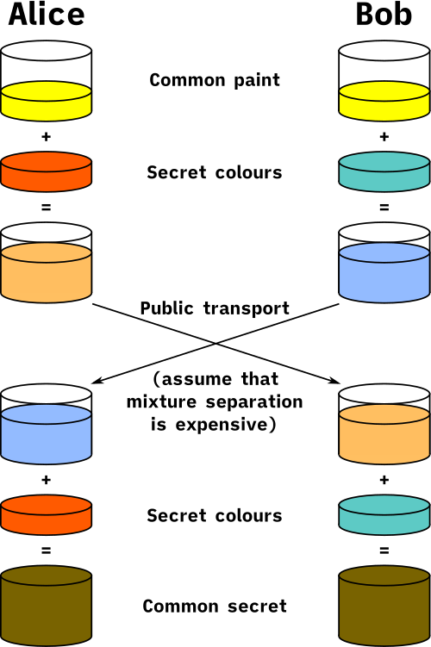
Secret Key derivation
Diffie Hellman Key Exchange
Pick p and g commonly known to both and must be relative primes
Alice use secret a and send A = g^a mod p
Bob use secret b and send B = g^b mod p
Alice compute s1 = B^a mod p = (g^b mod p) ^ a mod p = g^ab mod p
Bob compute s2 = A^b mod p = (g^a mod p) ^ b mod p = g^ab mod p
By the properties of primes and modulo arithmetic s1==s2 and we have established a shared key.

Slide 14
Authentication
Encryption and Integrity are useless if you agree to send your secrets to the wrong person
In some cases only one side needs to authenticate itself (i.e. the webserver you talk to doesn’t care who you are, but you care about who it is)
Phishing relies on you not noticing who you talk to

Slide 15
Authentication
TLS certs
Server has both a Pub and Priv key
Something encrypted with the Priv key can be decrypted by the Pub key
Something encrypted with the Pub key can be decrypted by the Priv key
Server send a hash of its certificate encrypted with the private key to client
Client decrypts the hash using the public key, calculates the hash independently and compares the decrypted with its own
Client send a random message to server encrypted with the public key and waits for the server to send the original message back.
Authentication completed!
Notes:
You need the random message to prevent replay attacks.

Slide 16
Authentication
Man in the middle can mess this up by intercepting the messages and substituting them with their own!
If the client had faith on the servers public key and cert by “knowing” what they are this problem goes away
Certificate authorities solve this problem

Slide 17
Authentication with CAs
Everyone has pre-installed certificates from well known CAs (i.e. Verisign, Digicert)
Server has their certification signed with CA’s private key which can then be decrypted with CA’s public key
Server must pay CA to have them sign their certificate (also called issue of certificate)

Slide 18
Types of validation
Domain validation (DV)
Prove you own the domain (typically show you own an email associated with the domain)
Organization validation
Additional details need to be verified.
Extended validation
With EV, nine additional steps are required including verifying a businesses’ public phone number, length of time in business, registration number and jurisdiction, as well as a domain fraud check, contact blacklist check and a telephone call to authenticate the employment status of the requestor.

Slide 19
HyperText Transfer Protocol (HTTP)
Built on top of TCP (or UDP more recently)
Most commonly built on top of TLS (HTTPS)
Connectionless and Stateless (A request does not depend on other requests, though it can have side-effects on the server)
Media independent (payload is independent of the protocol, and negotiated as part of the protocol)

Slide 20
HTTP Resources
URL vs URI vs URN
URL (Uniform Resource Locator) -- A name identifying a resource that can be fetched with HTTP (i.e. http://www.google.com)
URI (Uniform Resource Identifier) -- A name identifying a resource that may or may not be fetchable (URLs are URIs but not vice-versa) (i.e. xmlns:recipe = "https://chef.com/recipe")
URN (Uniform Resource Name) -- A name identifying a resource in a unique permanent way but not how to fetch it (i.e. urn:isbn:1234567890
URLs have the form protocol://domain[:port]/path[?parameters][#anchor]

Slide 21
Protocol information
Version: HTTP/1.0, HTTP/1.1, HTTP/2.0, HTTP/3.0
Last 2 must be encrypted over TLS
Message: Can contain headers and bodies
Headers are always human readable, key-value pairs
Bodies can be text or arbitrary binary data
Request methods
GET, HEAD, POST, PUT, DELETE, (CONNECT, OPTIONS, TRACE)
PUT vs POST
POST implies sending the server some data and letting the server decide which object they affect
PUT specifies the object and replaces its value with what is provided

Slide 22
HTTP Responses
1xx -- Informational. Request was received and being processed (an extra response will follow)
2xx -- Success. Request was processed successfully
3xx -- Redirect. The name of the resource has changed and more client action is required to complete the requests
4xx -- Client error. Something about the resource being requested is wrong.
5xx -- Server error. The server encountered an error and could not process the request

Slide 23
HTTP Headers
General headers -- Apply both to requests and responses (i.e. Cache-control, Upgrade, etc)
Client request headers -- Apply only to requests (i.e. Accept, Accept-Encoding, Cookie, Host, etc)
Server response headers -- Apply only to responses (i.e. Age, Etag, Location, Set-Cookie etc)
Entity headers -- Apply to the object being returned (i.e. Allow, Content-Length, Last-Modified, etc)

Slide 24
HTTP Caching
Client values
no-cache (ill named as you can cache but check with origin before using)
No-store (must not cache)
max-age, max-stale, min-fresh, no-transform, only-if-cached.
Server values
public (can be cached in shared mode)
private (can not be cached in shared mode)
no-cache (as in client)
no-store (as in client)
No-transform, must-revalidate, proxy-revalidate, max-age, s-maxage

Slide 25
Traffic shares and the advantages of QUIC/HTTP/3.0
Traffic Shares
HTTP/1.0 and HTTP/0.9: ~0.3%
HTTP/1.1: ~27%
HTTP/2.0: ~36%
HTTP/3.0: ~30%
Advantages of QUIC
No head of line blocking
Header compression
Encrypted protocol metadata (no transparent caching)
Faster loss recovery
Packet encryption vs record encryption
User space for faster iteration
https://storage.googleapis.com/pub-tools-public-publication-data/pdf/8b935debf13bd176a08326738f5f88ad115a071e.pdf
Examples using telnet on the terminal

Slide 26

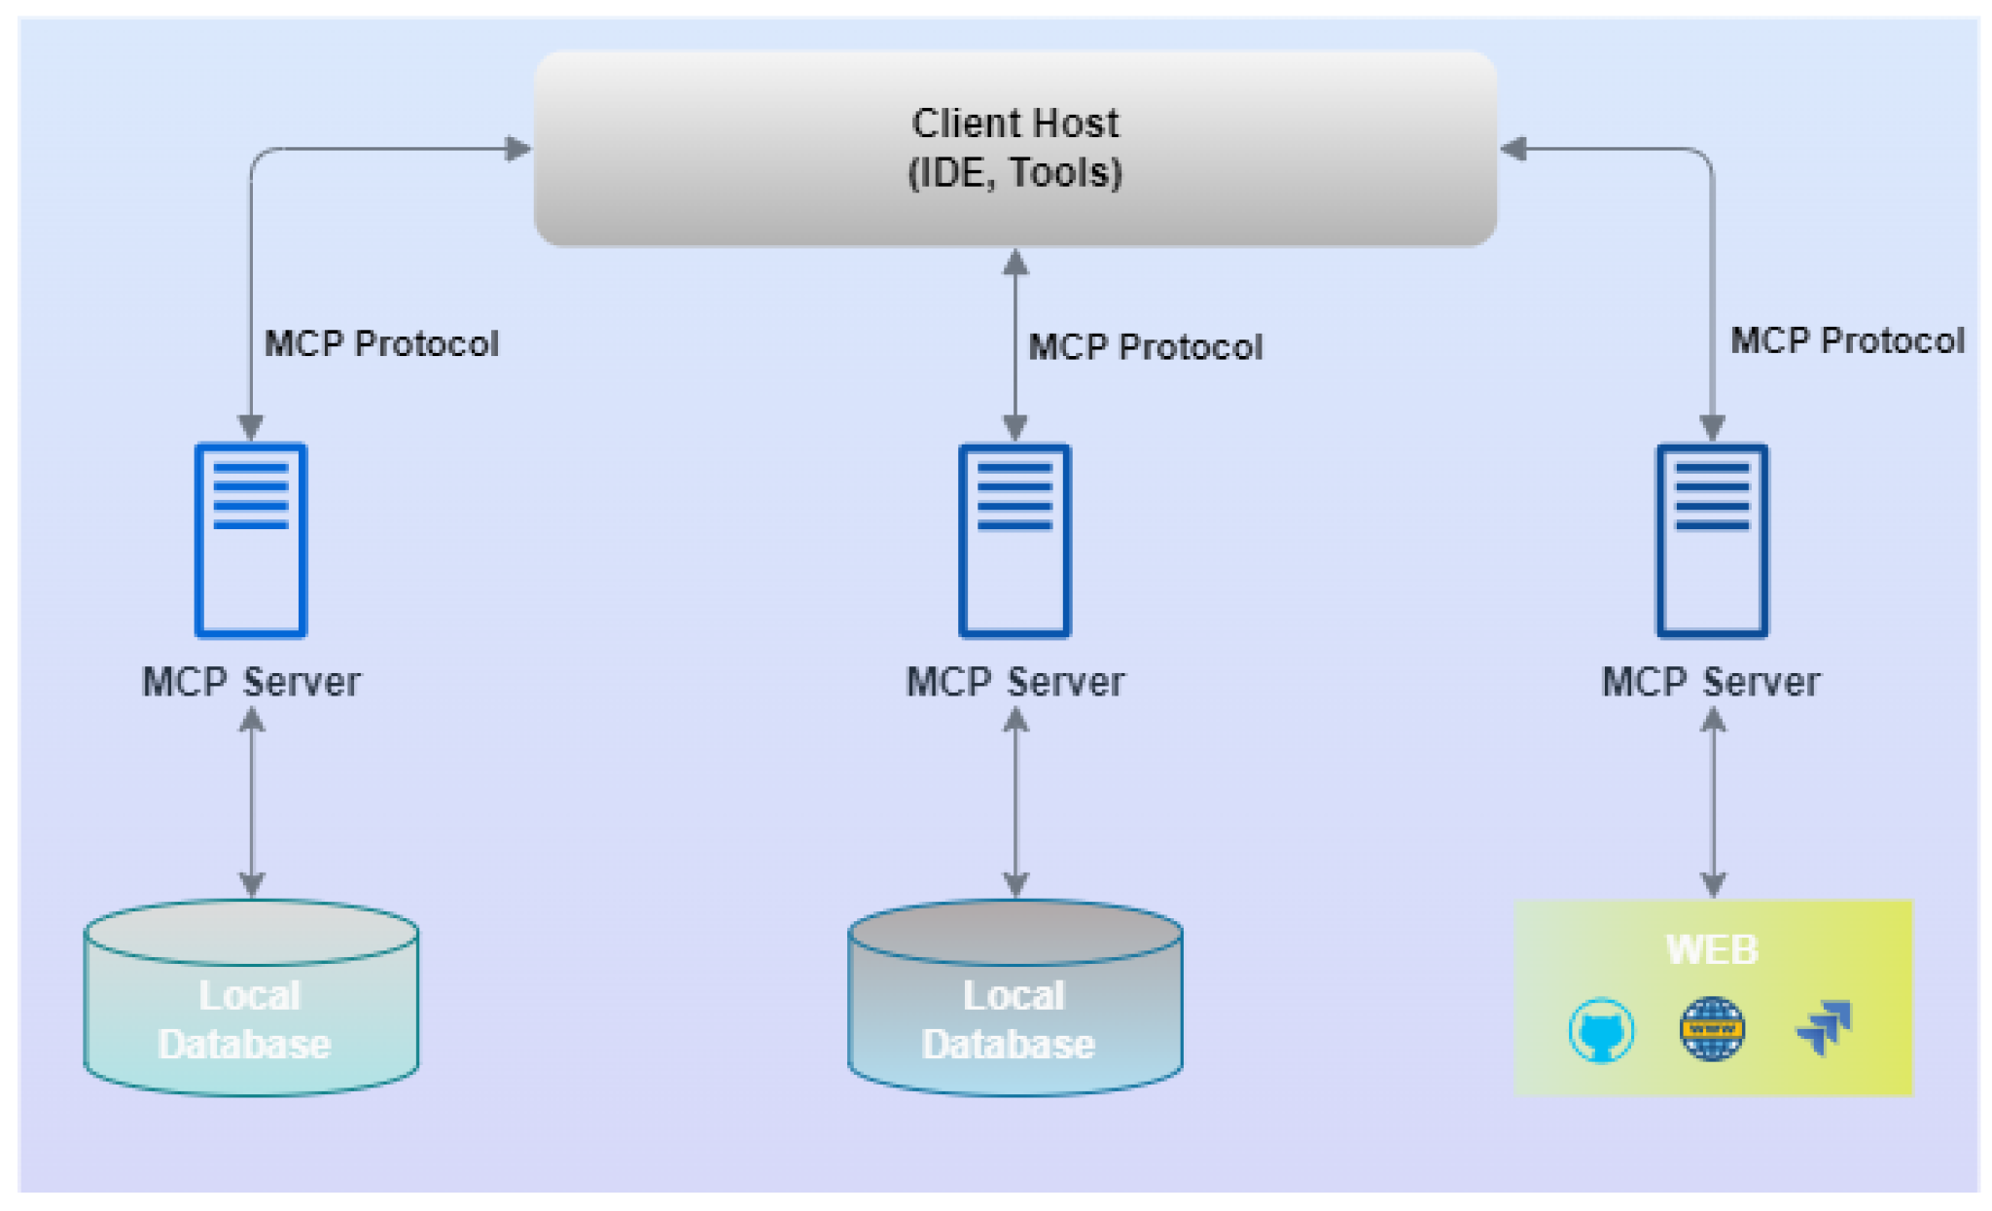
Model Context Protocol (MCP)
A good paper to read
The spec

Slide 27
MCP Entities
User: You Host: An application embedding an LLM/Agent and a Client Agent: A reasoning entity that can decide what it wants to do. A host can contain multiple agents. Host Policy: Constraints on what agents are allowed to do (i.e. access resources, passwords, credentials etc). Client: A software component sending messages on behalf of the Host, in response to agent logic, and subject to policy constraints. Server: A process exposing capabilities that can be accessed via MCP. Only the client gets to talk to the server. Not the user, not the LLM.

Slide 28
MCP Concepts: Resources
resources/list for complete enumeration
Typically paginated
resources/templates/list to discover resource templates
Then you can ask for resources within a template
Text resources (text, json, xml) and binary resources (base64 encoding for video, audio, images etc).
Client asks Server, typically to get information from the server that will help it do its job.

Slide 29
MCP concepts: Prompts
Servers providing advice to Agents
Agents can ignore them, they are not enforceable on the host/client side
Server can refuse service to requests that do not meet their prompt requirements
prompts/list the endpoint for discovering prompts
Client asks server on how best to send it requests to do certain tasks

Slide 30
MCP Concepts: Tools
tools/list and tool/call endpoints
Allow agent to perform actions.
Each tool has a schema attached to it, specifying its expected inputs and outputs. JSON is used for expressing schema. Inputs fully described. Output often only describe success case.

Slide 31
MCP Concepts: Sampling
The server can call the agent/LLM! Why?
May need some comments, additional information, rewriting of output, selection of strategy for a task etc.
We don’t want the server to make its own decisions so we allow the server to ask the client what it wants to do in those case (within the constraints of both the Host and the Server)
Sampling requests are carefully scoped to avoid servers injecting instructions into the client
If your host has sensitive data maybe it should not allow sampling!

Slide 32
MCP Concepts: Roots
Sometimes server can operate on client owned data/repo
Roots sets boundaries on where the server should operate
Boundaries are not enforceable!
Roots are irrelevant if servers operate on their own data

Slide 33
Errors
Transport level (HTTP) errors
MCP Protocol errors (i.e. bad argument, unavailable method, permissions)
Tool execution errors
Lifecycle (capability, session, etc)

Slide 34
MCP Protocol and Lifecycle Errors
Code Name Meaning in MCP Agent action
-32700 Parse error Invalid JSON Do not retry
-32600 Invalid Request Malformed MCP message Do not retry
-32601 Method not found Tool / method does not exist Fix tool name
-32602 Invalid params Arguments fail schema / shape Fix arguments
-32603 Internal error Server failed before execution Retry cautiously
{ "jsonrpc": "2.0", "id": 7 "error": { "code": -32602, "message": "Invalid params: missing required field 'path'" } }

Slide 35
MCP Tool execution errors
{ "jsonrpc": "2.0", "id": 12, "result": { "content": [ { "type": "text", "text": "Access denied: path is outside allowed root" } ], "isError": true } } Tool execution failures do not return an actual error but a result with the isError boolean set to true!

Slide 36
Quick Demo
# npx @modelcontextprotocol/inspector (A nodeJS MCP inspector library)
Connect to http://localhost:6274/?MCP_PROXY_AUTH_TOKEN=XXXXXXX
Set server to https://learn.microsoft.com/api/mcp and protocols to streamable HTTP
Browse the resources, tools, prompts, roots, etc.

Slide 37
Attendance poll
https://piazza.com/class/mkctevprups13o/post/159

